Slide 1
Time-Space Tradeoffs in Proof Complexity: Superpolynomial Lower Bounds for Superlinear Space
Chris Beck
Princeton University
Joint work with
Paul Beame & Russell Impagliazzo

Slide 2
SAT & SAT Solvers
SAT is central to both theory and practice
In the last ten years, there has been a revolution in practical SAT solving. Modern SAT solvers can sometimes solve practical instances with millions of variables.
Best current solvers use a Backtracking approach pioneered by DPLL ’62, plus an idea called Clause Learning developed in Chaff ‘99.

Slide 3
SAT & SAT Solvers
DPLL search requires very little memory
Clause learning adds new clauses to the CNF every time the search backtracks
Uses lots of memory to try to beat DPLL.
In practice, must use heuristics to guess which clauses are “important” and store only those. Hard to do well! Memory becomes a bottleneck.
Question: Is this inherent? Or can the right heuristics avoid the memory bottleneck?
Notes:
To a theoreticians eye, this looks like a case of Backtracking vs. Dynamic Programming. Can we show that there is a real tradeoff going on?
Can we prove formally that “Throwing memory” at SAT can help a lot?

Slide 4
SAT Solvers and Proofs
All SAT algorithms find a satisfying assignment or a proof of unsatisfiability.
Important for applications, not simply academic.
For “real” algorithms, these proofs take place in simple deductive proof systems, reflecting the underlying reasoning of the algorithm.
Proof can be thought of as a high level summary of the computation history.
Backtracking SAT Solvers correspond to Resolution

Slide 5
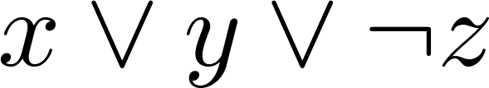
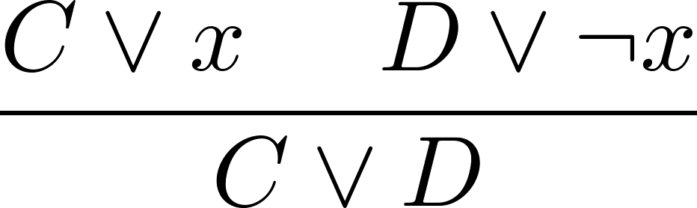
Resolution Proof System
Proof lines are clauses, one simple proof step
Proof is a sequence of clauses each of which is
an original clause, or
follows from previous clauses via resolution step
A CNF is UNSAT iff can derive empty clause ⊥
Notes:
First thing I need to do is introduce the Resolution proof system.
Easy to see step is sound.
System is in fact complete, which is the basis of using resolution to solve kSAT.

Slide 6
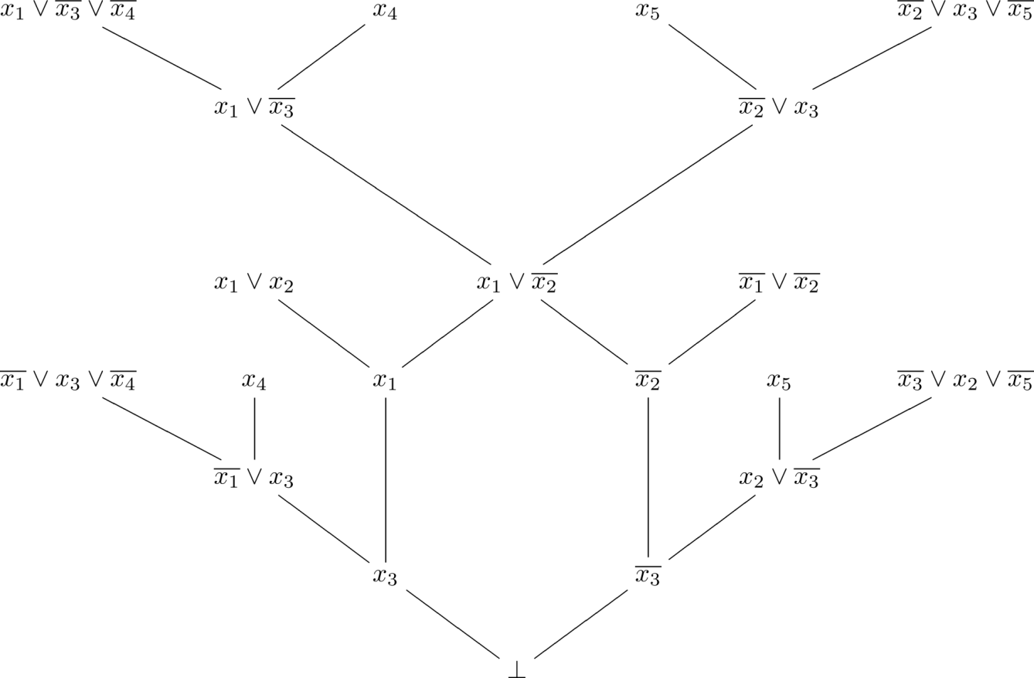
Proof DAG
General resolution: Arbitrary DAG
For DPLL algorithm, DAG is a tree.

Slide 7
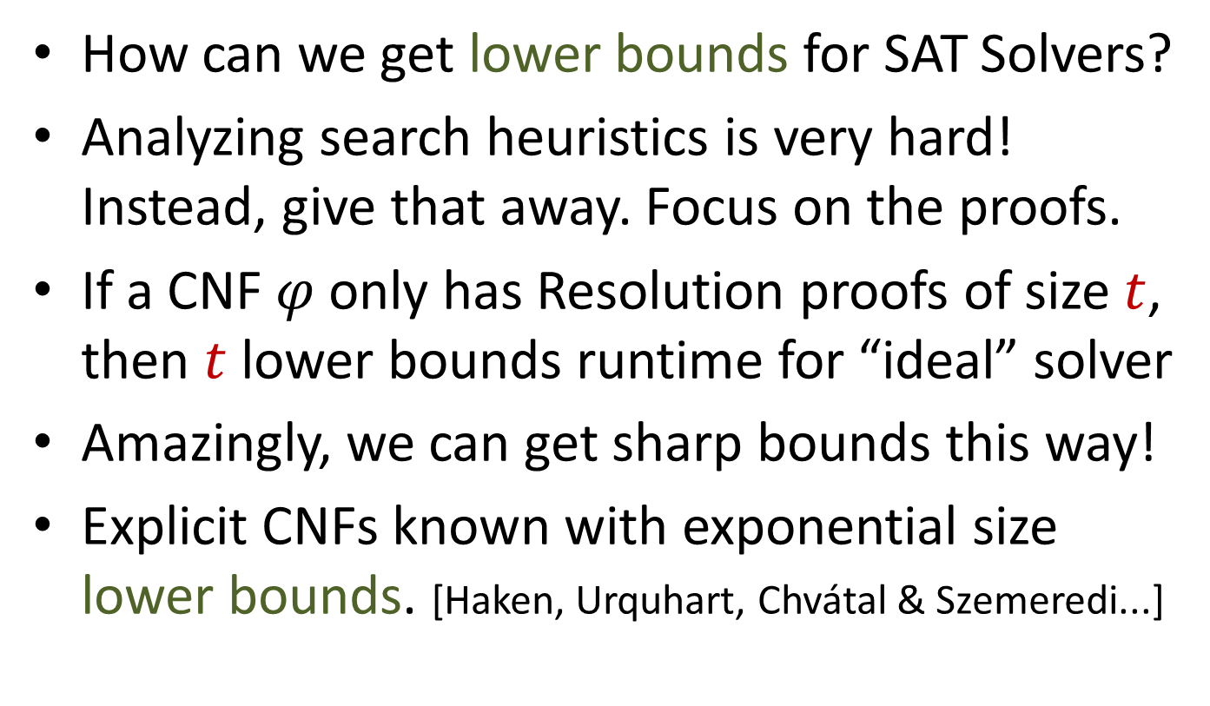
SAT Solvers and Proof Complexity
How can we get lower bounds for SAT Solvers?
Analyzing search heuristics is very hard! Instead, give that away. Focus on the proofs.
If a CNF $φ$ only has Resolution proofs of size $t$, then $t$ lower bounds runtime for “ideal” solver
Amazingly, we can get sharp bounds this way!
Explicit CNFs known with exponential size lower bounds. [Haken, Urquhart, Chvátal & Szemeredi...]

Slide 8
SAT Solvers and Proof Complexity
More recently, researchers want to investigate memory bottleneck for DPLL + Clause Learning
Question: If
Proof Size ≤ Time for Ideal SAT Solver,
can we define Proof Space so that
Proof Space ≤ Memory for Ideal SAT Solver,
and then prove strong lower bounds for Space?

Slide 9





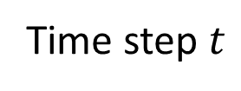


Space in Resolution
Clause space $≔ \max_{t}{(\# \text{active} \text{clauses}\text{)}}$. [Esteban, Torán ‘99]
…
$$C_{1}$$
$$C_{2}$$
$$x˅y$$
$$\overline{x}˅z$$
$$y˅z$$
$$⊥$$
Informally:
Clause Space of a proof = Number of clauses you need to hold in memory at once in order to carry out the proof.
Must be in memory
Time step $t$

Slide 10
Lower Bounds on Space?
Generic Upper Bound: All UNSAT formulas on 𝑛 vars have DPLL refutation in space ≤ 𝑛.
Sharp lower bounds are known for explicit tautologies. [ET’99, ABRW’00, T’01, AD’03]
So although we can get tight results for space, we can’t show superpolynomial space is needed this way – need to think about size-space tradeoffs.
In this direction: [Ben-Sasson, Nordström ‘10] Pebbling formulas with proofs in Size O(n), Space O(n), but Space O(n/log n) ⇒ Size exp(n^{Ω(1)}).
But, this is still only for sublinear space.

Slide 11

Size-Space Tradeoffs
Theorem: [Beame, B., Impagliazzo’12]
For any $k > 0$, there are formulas of size $n$ s.t.
There is a proof in $Size, Space ≈n^{k}$
For any proof, $Size≥ {\left(\frac{n^{.57k}}{Space}\right)}^{{\log{\log{n}}}/{\log{\log{\log{n}}}}}$
Eli Ben-Sasson asks formally: “Does there exist 𝑐 such that any CNF with a refutation of size T also has a refutation of size T^{𝑐} in space O(𝑛)?”
Notes:
In fact k here can be any function at most n^epsilon

Slide 12

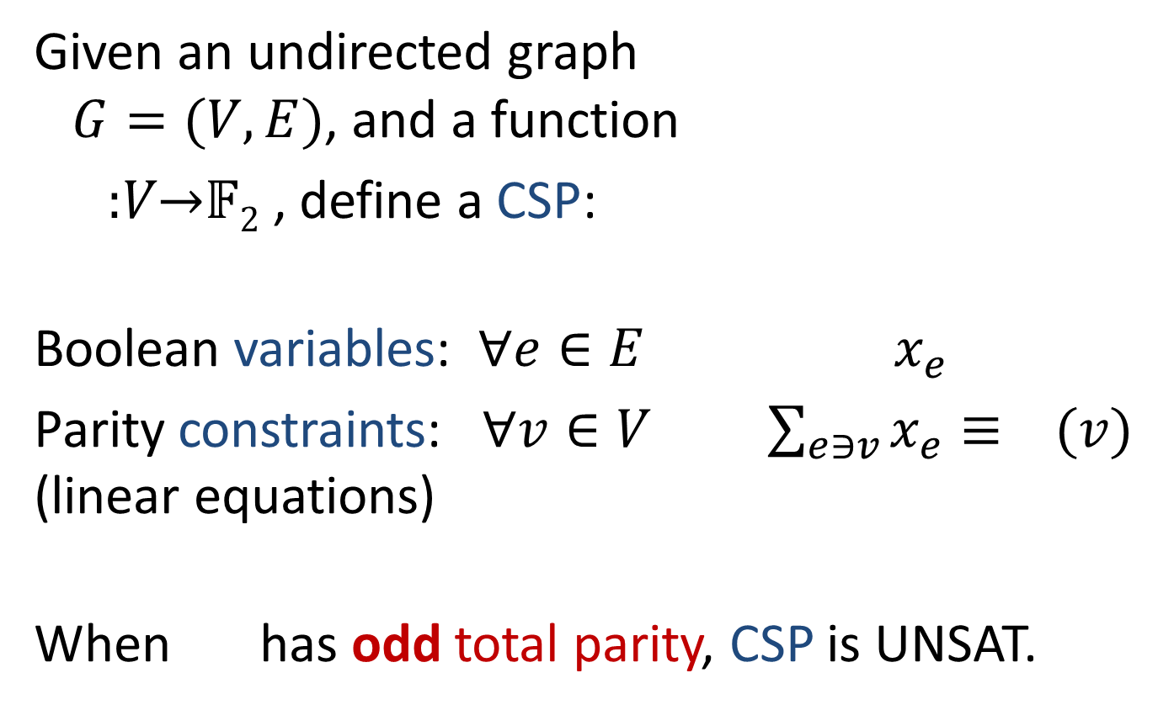
Tseitin Tautologies
0
Given an undirected graph $G=(V,E)$, and a function
:𝑉→𝔽₂ , define a CSP:
Boolean variables: $∀e∈E$ $x_{e}$
Parity constraints: $∀v∈V$ $\sum_{e∋v}{x_{e}}≡ (v)$ (linear equations)
When has odd total parity, CSP is UNSAT.
1
0
Notes:
Very well studied class of formulas for lower bounds, which we will use for our result.

Slide 13
Tseitin Tautologies
When χ odd, G connected, corresponding CNF is called a Tseitin tautology. [Tseitin ‘68]
Specifics of χ don’t matter, only total parity. The graph is what determines the hardness.
Known to be hard with respect to Size and Space when G is a constant degree expander. [Urquhart ‘87, Torán ‘99]
This work: Tradeoffs on 𝒏 × 𝒍 grid, 𝒍 ≫ 𝒏, and similar graphs, using isoperimetry.
Notes:
Why do we work on the Grid? Need it to be solvable in polynomial time to get the result as stated. We operate on a long & skinny grid. More generally, you could do a very large stack of small bipartite expander graphs, but this will only change the constants. Grid is clearer. Also grid was original case in which it was studied.
Urqhart: Hard Examples
Omega determined by degree, expansion parameter.
First using prover – adversary game,
Second using size-width tradeoffs.
Mention that, actually holds for a more general class of graphs – constants are slightly better working on stacked bipartite expanders instead of grid, but it doesn’t really make much difference.
Can mention that Grid was the original graph studied by Tseitin himself in 1968.

Slide 14

Tseitin formula on Grid
Consider Tseitin formula on 𝒏 × 𝒍 grid, 𝒍=4$n^{2}$
How can we build a resolution refutation?
n
l

Slide 15
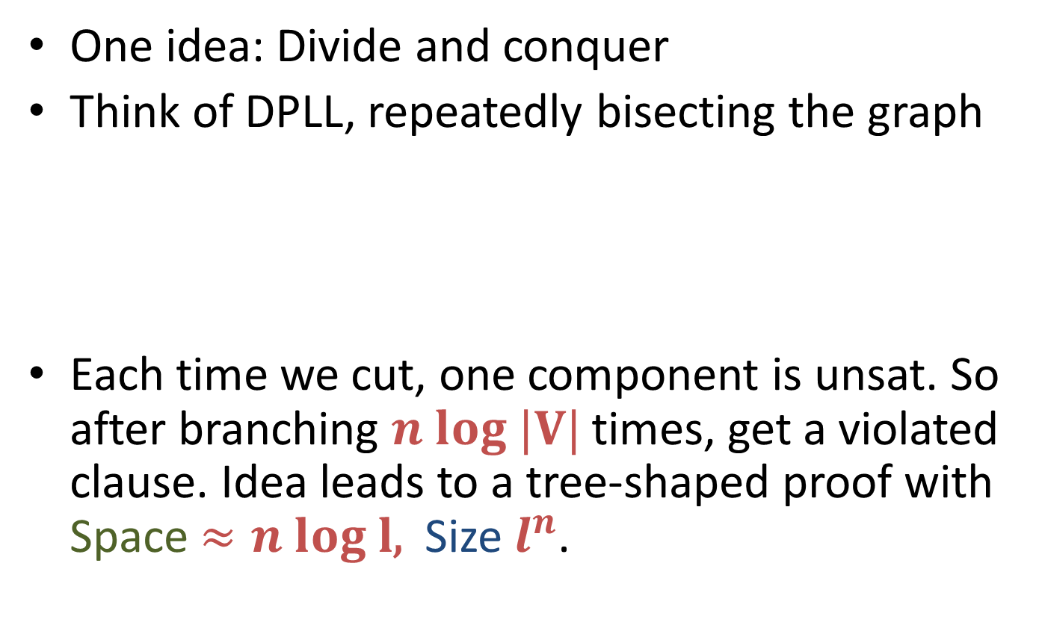
Tseitin formula on Grid
One idea: Divide and conquer
Think of DPLL, repeatedly bisecting the graph
Each time we cut, one component is unsat. So after branching $n log |V|$ times, get a violated clause. Idea leads to a tree-shaped proof with Space $≈n log l$, Size $l^{n}$.
n
l

Slide 16
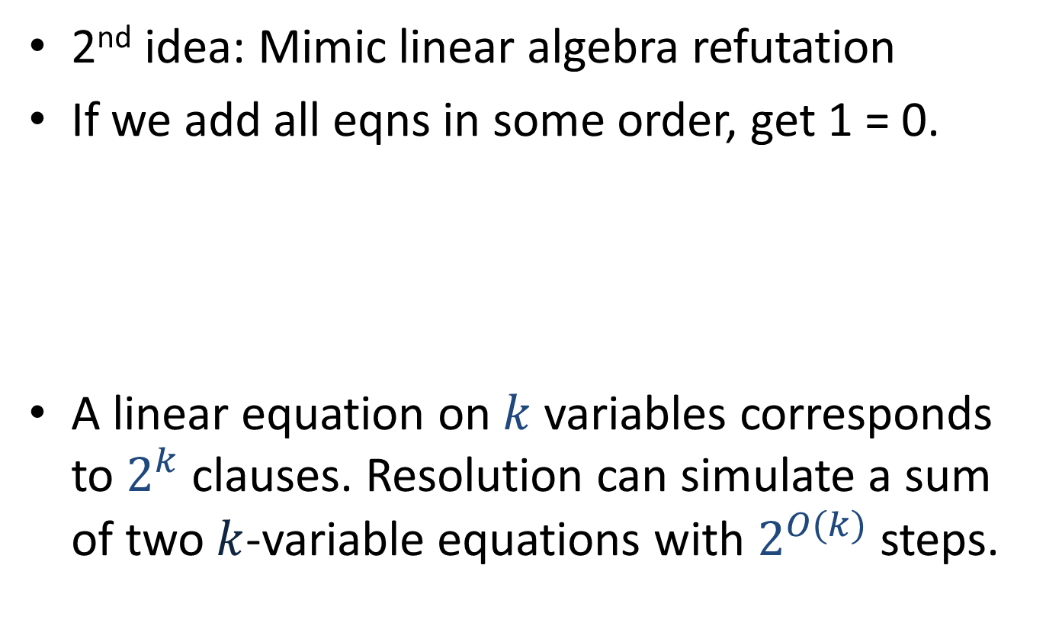
Tseitin formula on Grid
2nd idea: Mimic linear algebra refutation
If we add all eqns in some order, get 1 = 0.
A linear equation on $k$ variables corresponds to $2^{k}$ clauses. Resolution can simulate a sum of two $k$-variable equations with $2^{O(k)}$ steps.
n
l

Slide 17
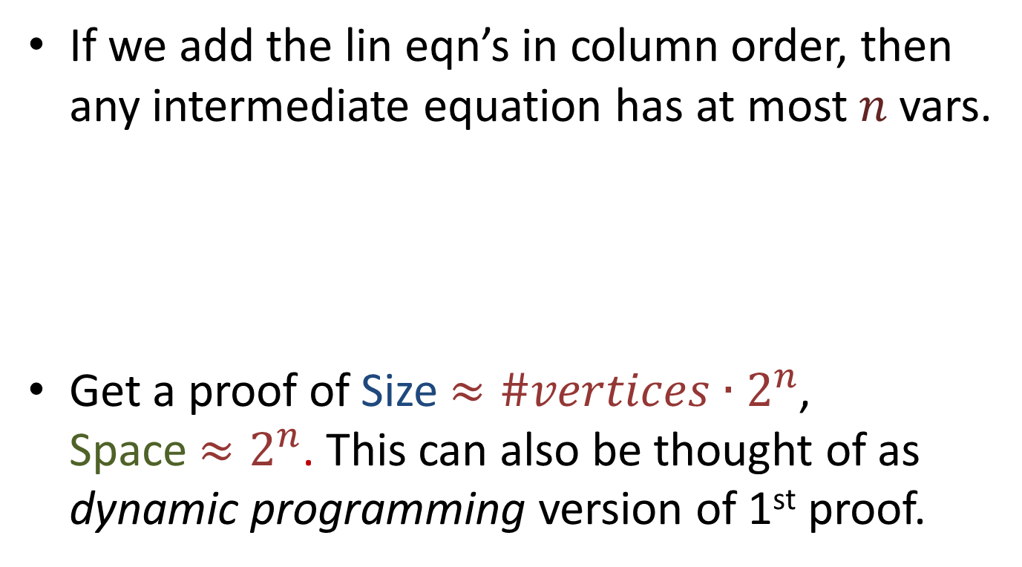
Tseitin formula on Grid
If we add the lin eqn’s in column order, then any intermediate equation has at most $n$ vars.
Get a proof of Size $≈\#vertices∙2^{n}$, Space $≈2^{n}$. This can also be thought of as dynamic programming version of 1st proof.
n
l

Slide 18
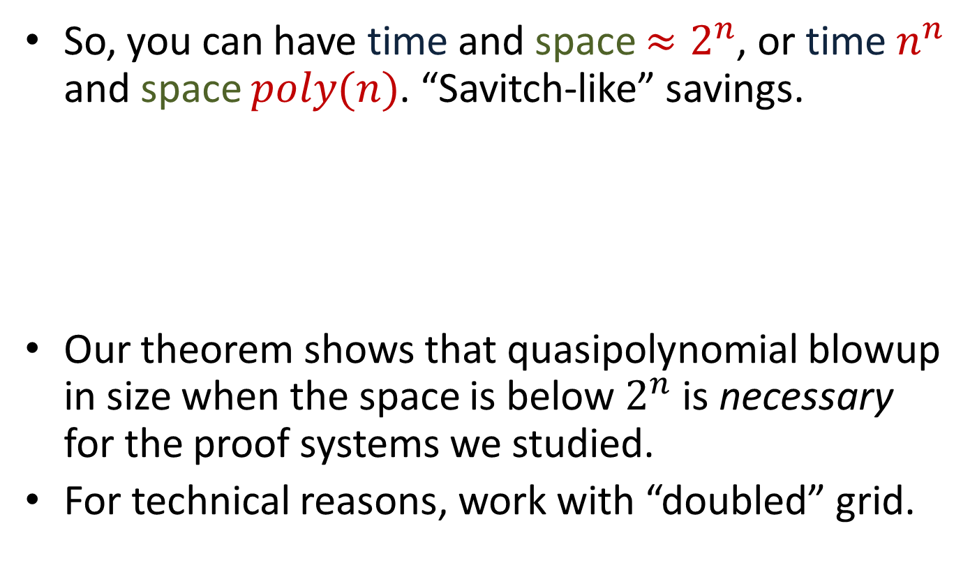
Tseitin formula on Grid
So, you can have time and space $≈2^{n}$, or time $n^{n}$ and space $poly(n)$. “Savitch-like” savings.
Our theorem shows that quasipolynomial blowup in size when the space is below $2^{n}$ is necessary for the proof systems we studied.
For technical reasons, work with “doubled” grid.
n
l

Slide 19
Warmup Proof
Our size/space lower bound draws on the ideas of one of the main size lower bound techniques. [Haken, Beame Pitassi ‘95].
To illustrate the ideas behind our result, we’ll first give the details of the Beame Pitassi result, then show how to build on it to get a size/space tradeoff.

Slide 20
Warmup Proof
The plan is to show that any refutation of the 2x grid formula must contain many different wide clauses.
First, we show that any refutation of the 1x grid formula must contain at least one wide clause.
Then, we use a random restriction argument to “boost” this, showing that proofs of 2x grid contain many wide clauses.

Slide 21
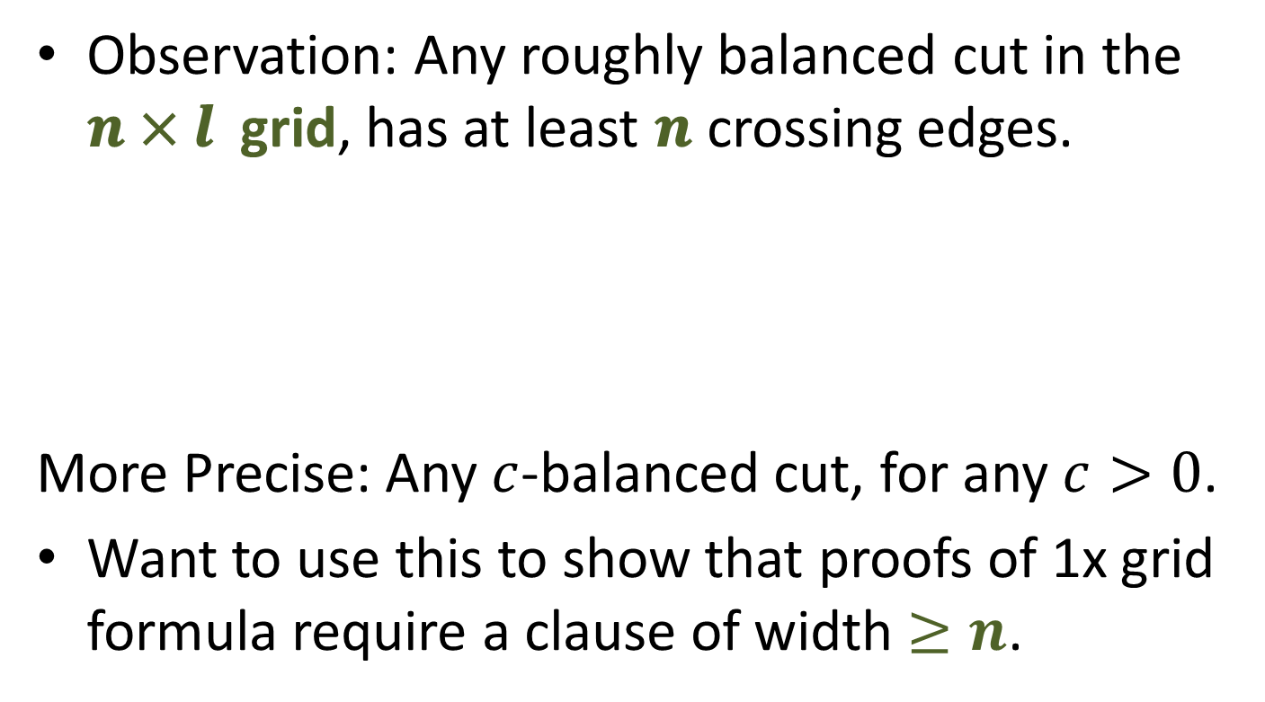
Warmup Proof
Observation: Any roughly balanced cut in the 𝒏 × 𝒍 grid, has at least 𝒏 crossing edges.
More Precise: Any $c$-balanced cut, for any $c>0$.
Want to use this to show that proofs of 1x grid formula require a clause of width $≥n$.
n
l

Slide 22
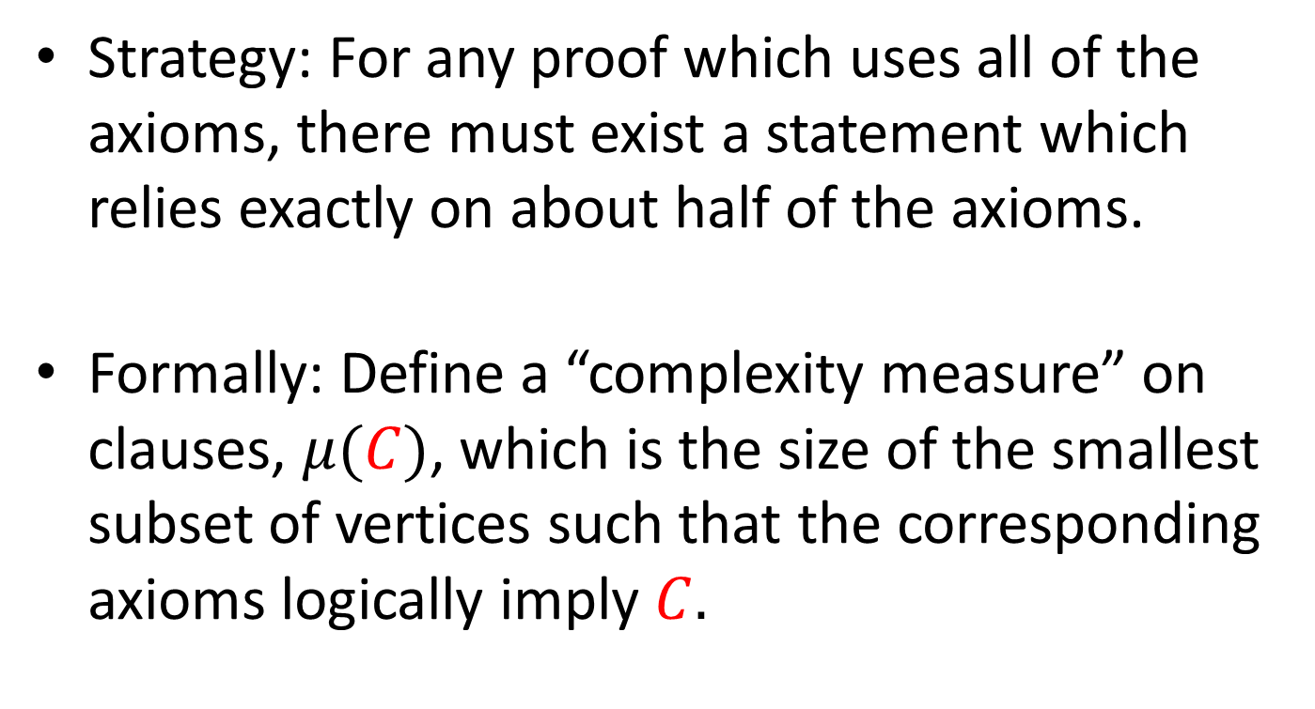
Warmup Proof: One Wide Clause
Strategy: For any proof which uses all of the axioms, there must exist a statement which relies exactly on about half of the axioms.
Formally: Define a “complexity measure” on clauses, $μ(C)$, which is the size of the smallest subset of vertices such that the corresponding axioms logically imply $C.$

Slide 23
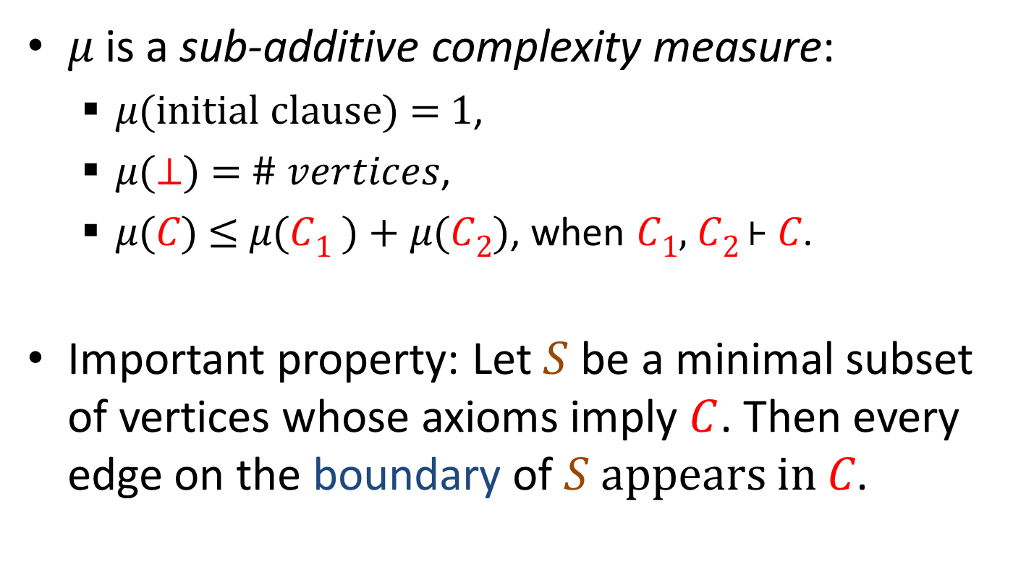
Warmup Proof: One Wide Clause
𝜇 is a sub-additive complexity measure:
𝜇(initial clause) = 1,
𝜇(⊥) = # 𝑣𝑒𝑟𝑡𝑖𝑐𝑒𝑠,
𝜇(𝐶) ≤ 𝜇(𝐶₁ ) + 𝜇(𝐶₂), when 𝐶₁, 𝐶₂ ⊦ 𝐶.
Important property: Let $S$ be a minimal subset of vertices whose axioms imply $C$. Then every edge on the boundary of $S$ appears in 𝐶.
Notes:
This theme appears in all work on Tseitin tautologies

Slide 24
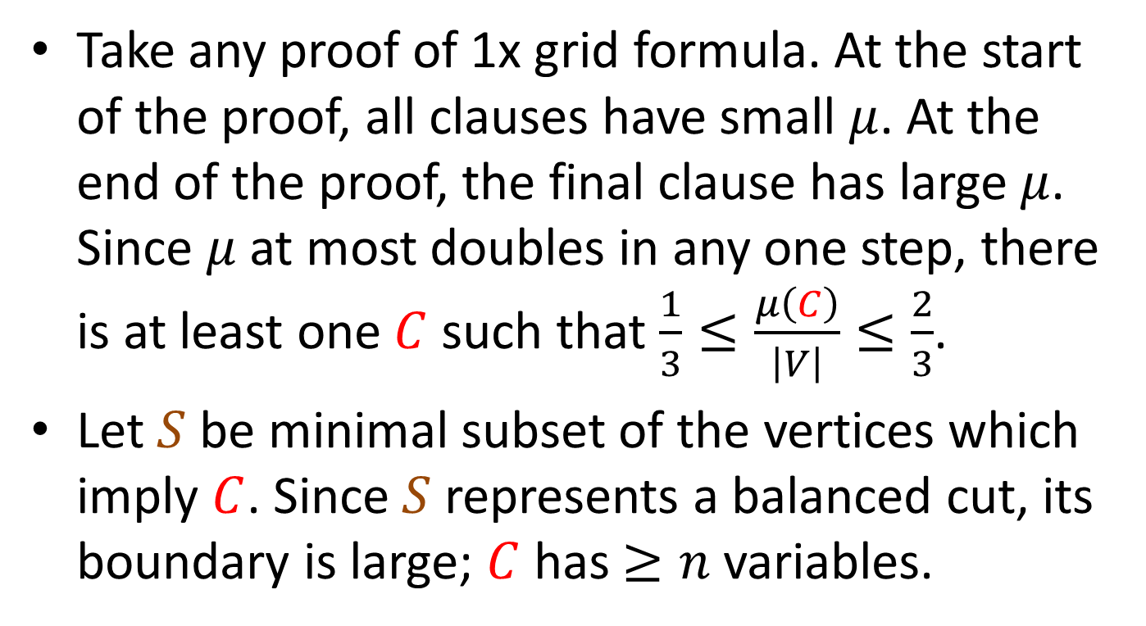
Warmup Proof: One Wide Clause
Take any proof of 1x grid formula. At the start of the proof, all clauses have small $μ$. At the end of the proof, the final clause has large $μ$. Since $μ$ at most doubles in any one step, there is at least one $C$ such that $\frac{1}{3}≤\frac{μ\left(C\right)}{\left|V\right|}≤\frac{2}{3}$.
Let $S$ be minimal subset of the vertices which imply $C$. Since $S$ represents a balanced cut, its boundary is large; $C$ has $≥n$ variables.

Slide 25
Warmup Proof: Many Clauses
A restriction is a partial assignment to the variables of a formula, resulting in some simplification. Consider choosing a random restriction for 2x grid which for each edge pair, randomly sets one to a random constant.
Poof!
n
l

Slide 26
Warmup Proof: Many Clauses
A restriction is a partial assignment to the variables of a formula, resulting in some simplification. Consider choosing a random restriction for 2x grid which for each edge pair, randomly sets one to a random constant.
Then formula always simplifies to the 1x grid.
n
l

Slide 27
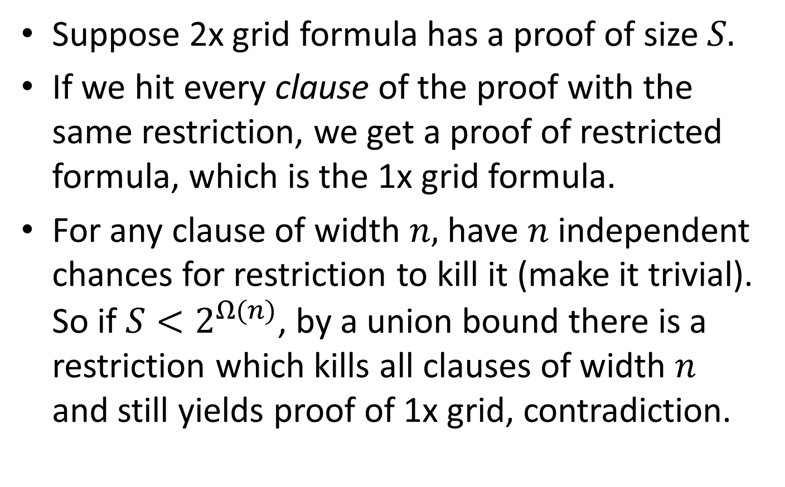
Warmup Proof: Many Clauses
Suppose 2x grid formula has a proof of size $S.$
If we hit every clause of the proof with the same restriction, we get a proof of restricted formula, which is the 1x grid formula.
For any clause of width $n,$ have $n$ independent chances for restriction to kill it (make it trivial). So if $S<2^{Ω(n)}$, by a union bound there is a restriction which kills all clauses of width $n$ and still yields proof of 1x grid, contradiction.

Slide 28
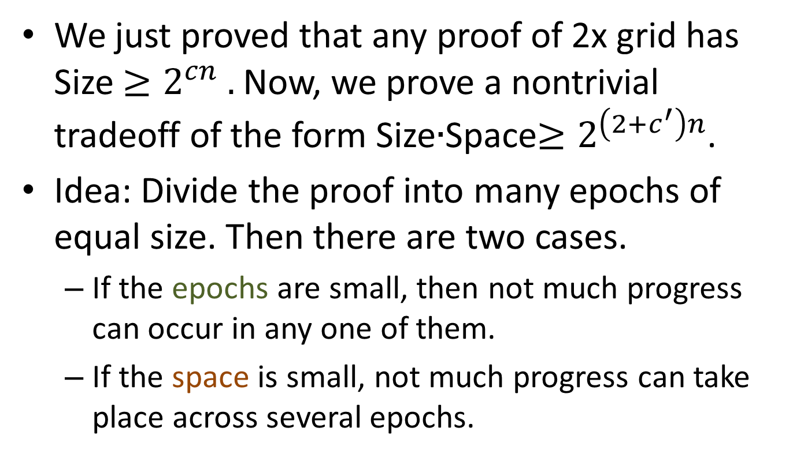
Size Space Tradeoff
We just proved that any proof of 2x grid has Size $≥2^{cn} .$ Now, we prove a nontrivial tradeoff of the form Size$∙$Space$≥2^{\left(2+c^{′}\right)n}$.
Idea: Divide the proof into many epochs of equal size. Then there are two cases.
If the epochs are small, then not much progress can occur in any one of them.
If the space is small, not much progress can take place across several epochs.

Slide 29
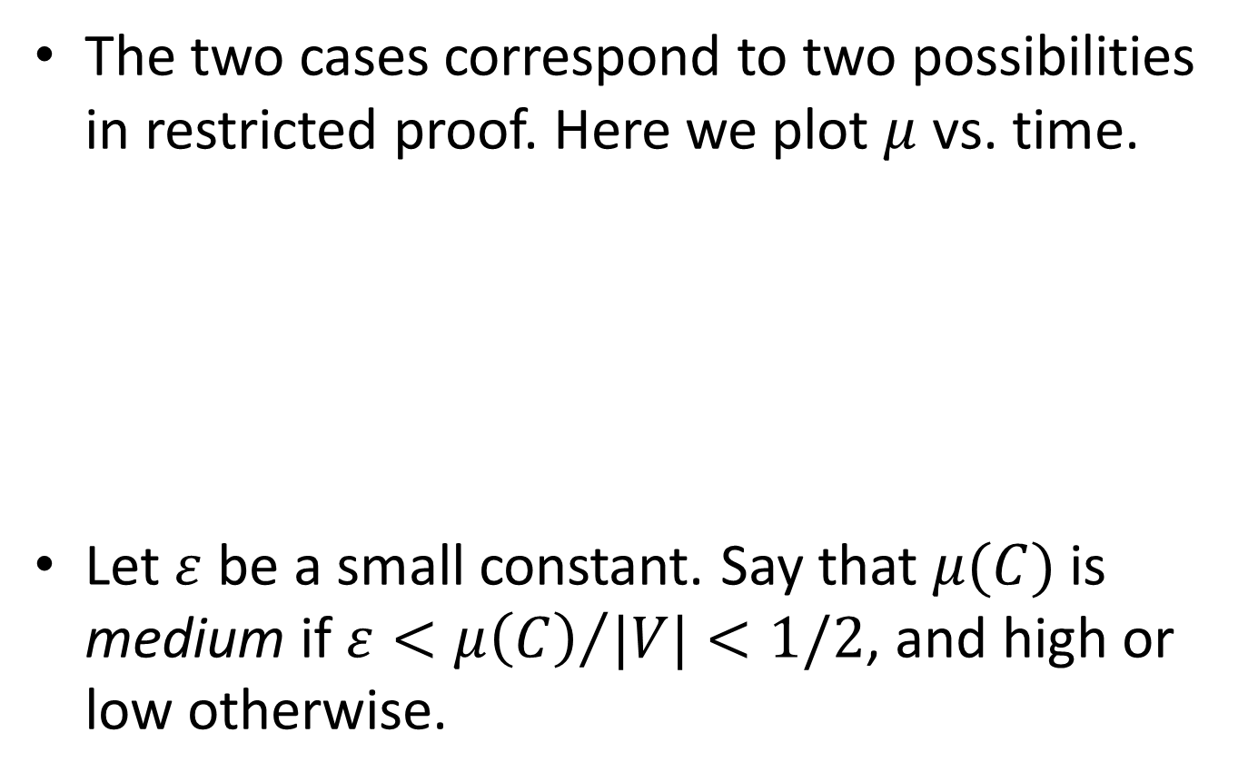
Complexity vs. Time
The two cases correspond to two possibilities in restricted proof. Here we plot $μ$ vs. time.
Let $ε$ be a small constant. Say that $μ(C)$ is medium if $ε<{μ\left(C\right)}/{|V|}<1/2$, and high or low otherwise.
Hi
Med
Low
Time

Slide 30

Two Possibilities
Either, a medium clause appears in memory during one breakpoint between epochs,
If $Epochs∙Space≪2^{n}$, this is unlikely, by a union bound.
Hi
Med
Low
Time

Slide 31

Two Possibilities
Or, all breakpoints only have Hi and Low.
Must have an epoch which starts Low ends Hi, and so has $\log{1/ε}$ clauses of superincreasing $μ$ values, by subadditivity.
Hi
Med
Low
Time
Notes:
BY SUBADDITIVITY.

Slide 32

Isoperimetry in the Grid
Observation: If we have $k$ medium subsets of the grid of superincreasing sizes, have at least $kn$ edges in the union of their boundaries.
n

Slide 33
Isoperimetry in the Grid
Observation: If we have $k$ medium subsets of the grid of superincreasing sizes, have at least $kn$ edges in the union of their boundaries.
n

Slide 34
Isoperimetry in the Grid
Observation: If we have $k$ medium subsets of the grid of superincreasing sizes, have at least $kn$ edges in the union of their boundaries.
n

Slide 35
Isoperimetry in the Grid
Observation: If we have $k$ medium subsets of the grid of superincreasing sizes, have at least $kn$ edges in the union of their boundaries.
n

Slide 36
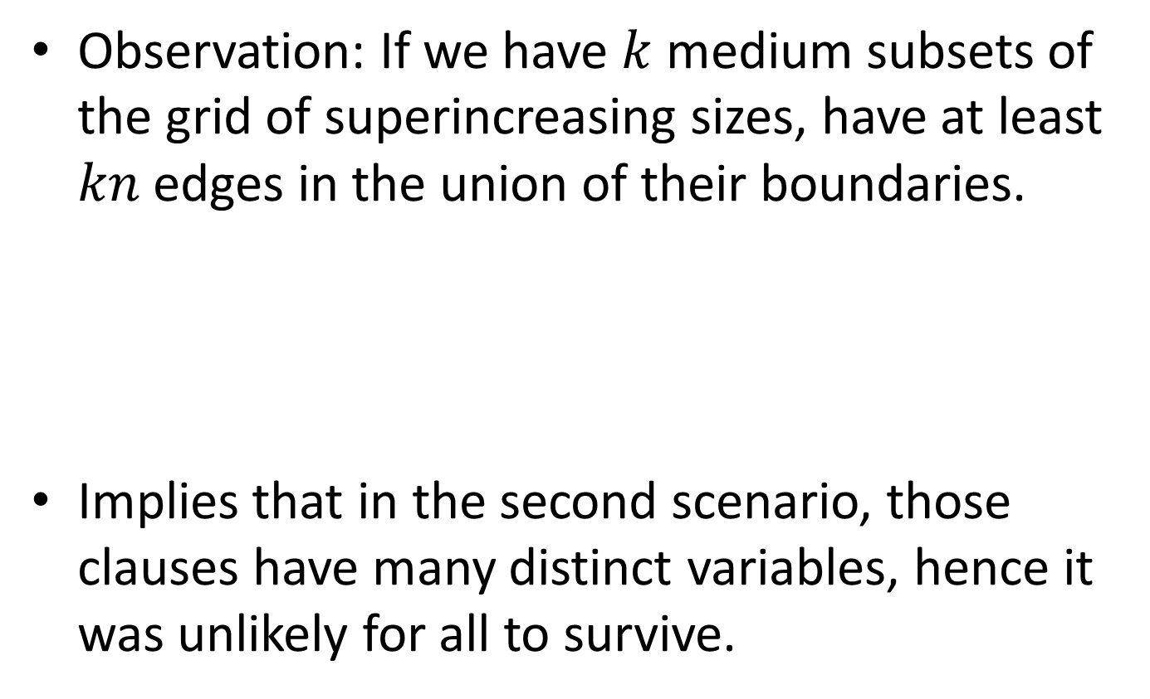
Isoperimetry in the Grid
Observation: If we have $k$ medium subsets of the grid of superincreasing sizes, have at least $kn$ edges in the union of their boundaries.
Implies that in the second scenario, those clauses have many distinct variables, hence it was unlikely for all to survive.
n

Slide 37
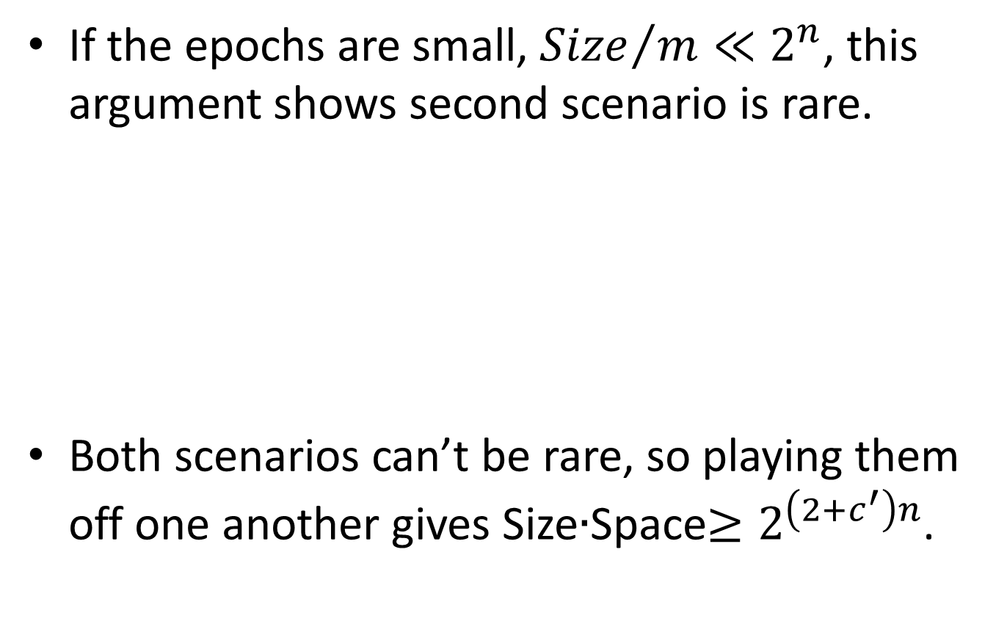
Two Possibilities
If the epochs are small, ${Size}/m≪2^{n}$, this argument shows second scenario is rare.
Both scenarios can’t be rare, so playing them off one another gives Size$∙$Space$≥2^{\left(2+c^{′}\right)n}$.
Hi
Med
Low
Time
Notes:
BY SUBADDITIVITY.

Slide 38
Full Result
To get the full result in [BBI’12], don’t just subdivide into epochs once, do it recursively. Uses a more sophisticated case analysis on progress.
The full result can also be extended to Polynomial Calculus Resolution, an algebraic proof system which manipulates polynomials rather than clauses. In [BNT’12], we combined the ideas of [BBI’12], [BGIP’01] to achieve this.

Slide 39
Open Questions
More than quasi-polynomial separations?
For Tseitin formulas upper bound for small space is only a log n power of the unrestricted size
Candidate formulas? Are these even possible?
Tight result for Tseitin? A connection with a pebbling result [Paul, Tarjan’79] may show how.
Can we get tradeoffs for Cutting Planes? Monotone Circuits? Frege subsystems?

Slide 40
Thanks!

Slide 45
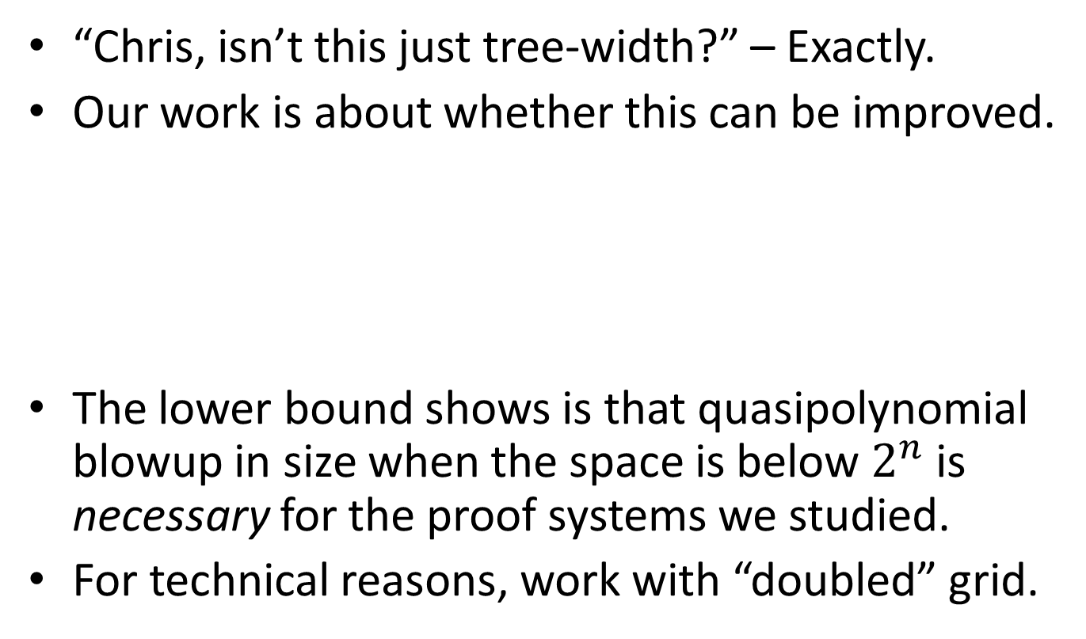
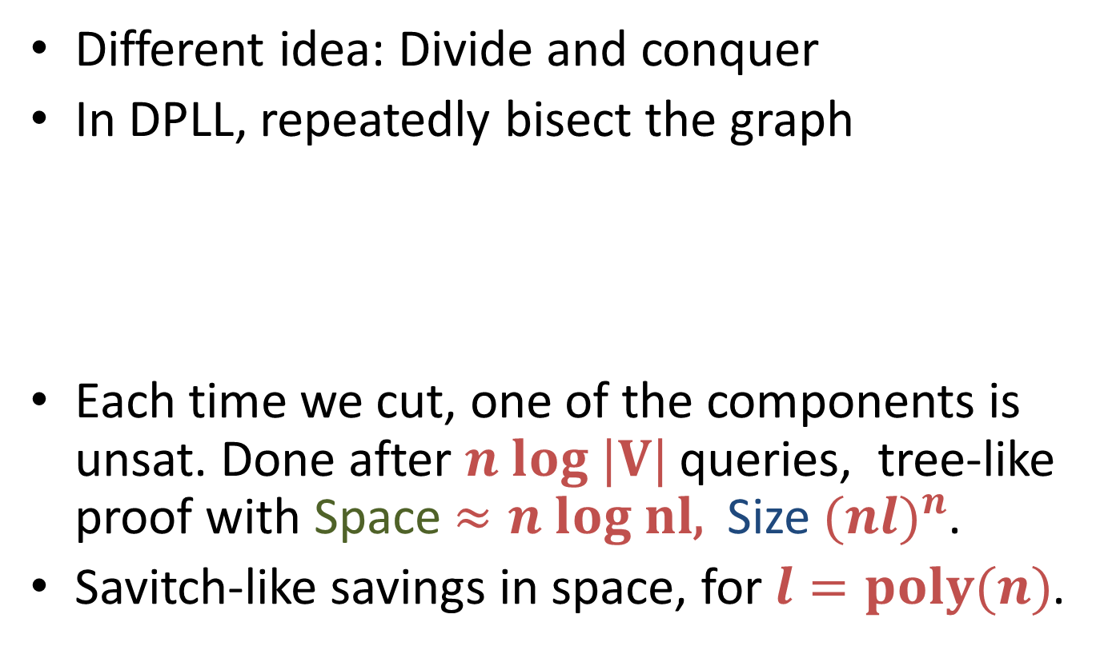

Analogy with Flows, Pebbling
In any Resolution proof, can think of a truth assignment as following a path in the proof dag, stepping along falsified clauses.
Path starts at empty clause, at the end of the proof.
Branch according to resolved variable.
$$C∨x$$
$$D∨¬x$$
If x = 1…
$$C∨D$$

Slide 46

Analogy with Flows, Pebbling
Then the random restriction argument can be viewed as a construction of a distribution on truth assignments following paths that are unlikely to hit complex clauses.
Initial Clauses
“Bottlenecks” (complex clauses)
$⊥$

Slide 47


Analogy with Flows, Pebbling
Initial Points
Suppose that for any particular , , $\operatorname{Pr}\left[ \right]≤p,\operatorname{Pr}\left[ \right]≤p,$ $\operatorname{Pr}\left[ and \right]≤p^{2}.$ Then to pebble with k pebbles, $T^{2}∙k≥p^{−3}$.
Middle Layer 1
Middle Layer 2
$Target$

Slide 48
Analogy with Flows, Pebbling
In a series of papers, [Paul, Tarjan ‘79], [Lengauer, Tarjan ’80?] an epoch subdivision argument appeared for pebblings which solved most open questions in graph pebbling. Their argument works for graphs formed from stacks of expanders, superconcentrators, etc.
The arguments seem closely related. However, theirs scales up exponentially with # of stacks, ours scales up exponentially with log #stacks.

Slide 51
SAT Solvers
Well-known connection between Resolution and SAT solvers based on Backtracking
These algorithms are very powerful
sometimes can quickly handle CNF’s with millions of variables.
On UNSAT formulas, computation history yields a Resolution proof.
Tree-like Resolution ≈ DPLL algorithm
General Resolution ≿ DPLL + “Clause Learning”
Best current SAT solvers use this approach

Slide 55
Overview of Lower Bound
To get a time space tradeoff, divide the proof into a large number of epochs and a case analysis involving the progress measure:
Either, progress is saved during the breakpoints between epochs (difficult with small space)
Or, progress happens within an epoch. (difficult if epochs are small)
Simple arguments in restricted proof boost to almost tight bounds in unrestricted proof.

Slide 56
Overview of Lower Bound
Suppose the space used by the proof is small. Divide the proof into epochs of equal sizes, and hit it with the random restriction.
The number of epochs times the space bounds the number of clauses appearing at breakpoints between epochs. If their number is small, then with high probability, none of them has a “medium’ value of mu.

Slide 58
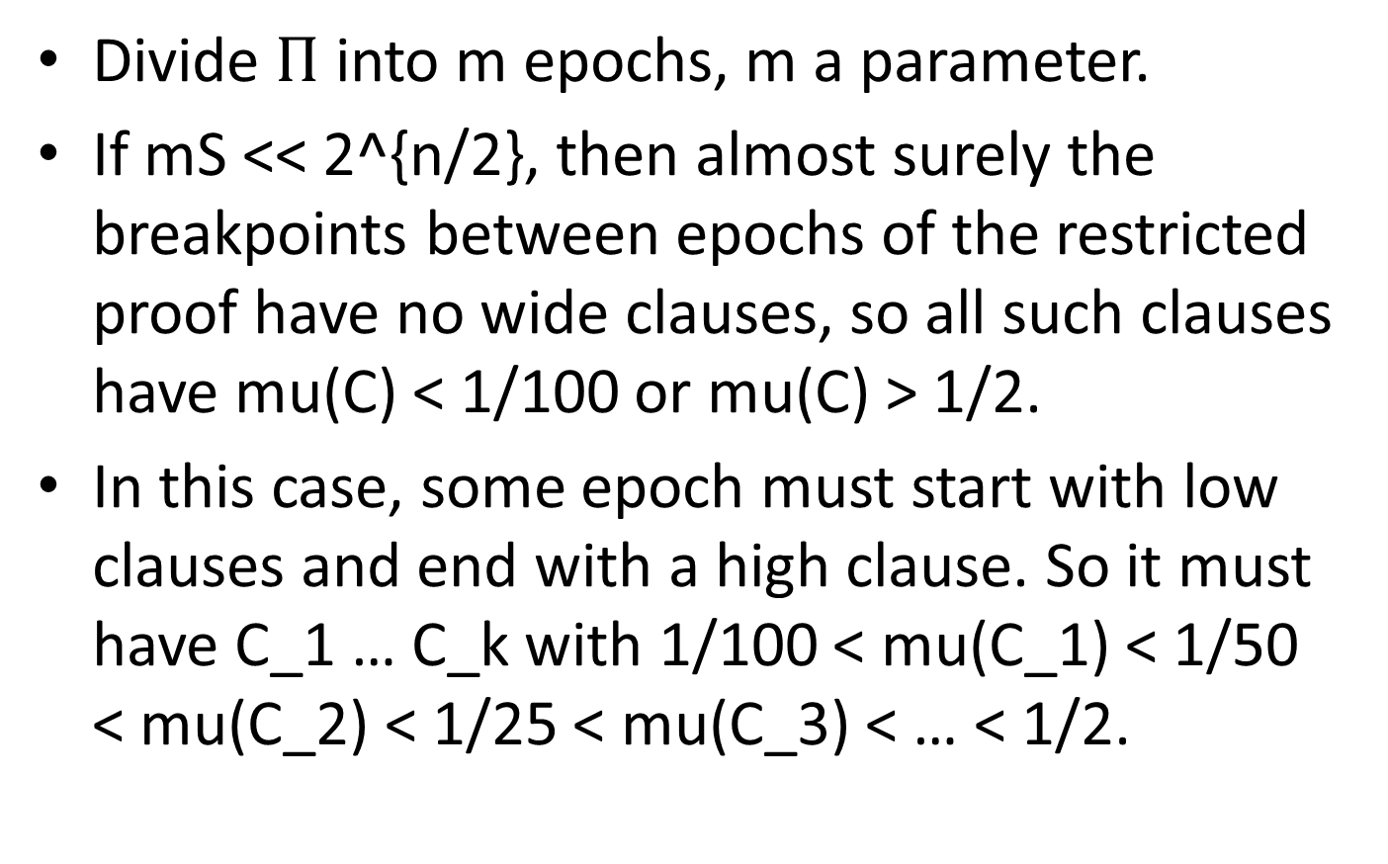
Overview of Lower Bound
Divide $Π$ into m epochs, m a parameter.
If mS << 2^{n/2}, then almost surely the breakpoints between epochs of the restricted proof have no wide clauses, so all such clauses have mu(C) < 1/100 or mu(C) > 1/2.
In this case, some epoch must start with low clauses and end with a high clause. So it must have C_1 … C_k with 1/100 < mu(C_1) < 1/50 < mu(C_2) < 1/25 < mu(C_3) < … < 1/2.

Slide 59
Overview of Lower Bound
Main technical step: Show that if an epoch contains few clauses, restriction is unlikely to have C_1 … C_k’ of superincreasing mu values.
Need to do better than a union bound over all clauses, or result will be trivial.
Main Idea: Show that any such C_1 … C_k’ have Omega(k’ n) variables collectively. If so, then by a union bound over k’ tuples, Pr[ E has k’ superincreasing] < (|E| 2^{-w})^k’

Slide 60
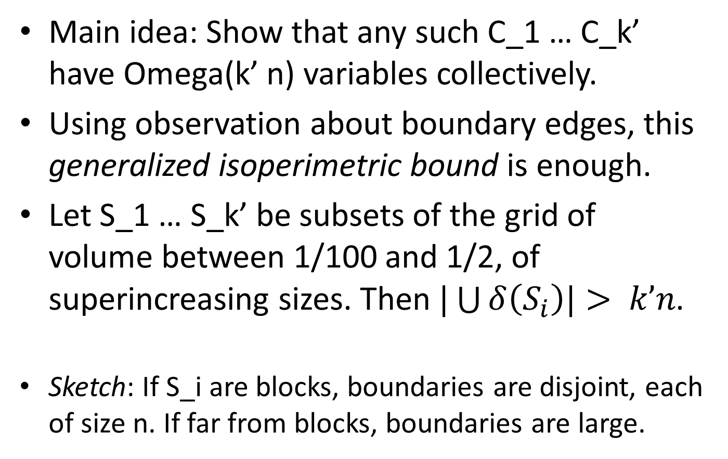
Overview of Lower Bound
Main idea: Show that any such C_1 … C_k’ have Omega(k’ n) variables collectively.
Using observation about boundary edges, this generalized isoperimetric bound is enough.
Let S_1 … S_k’ be subsets of the grid of volume between 1/100 and 1/2, of superincreasing sizes. Then $|\bigcup{δ\left(S_{i}\right)|}> k’n$.
Sketch: If S_i are blocks, boundaries are disjoint, each of size n. If far from blocks, boundaries are large.

Slide 61
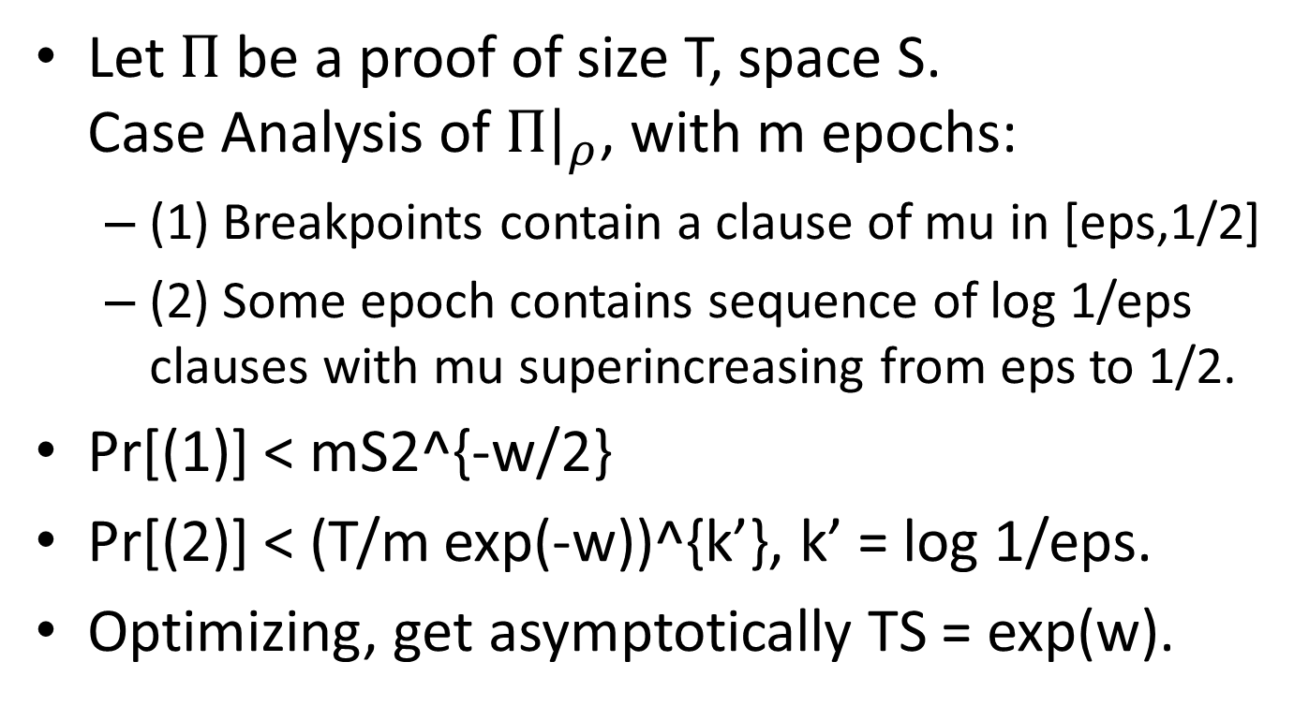
Overview of Lower Bound
Let $Π$ be a proof of size T, space S. Case Analysis of ${Π|}_{ρ}$, with m epochs:
(1) Breakpoints contain a clause of mu in [eps,1/2]
(2) Some epoch contains sequence of log 1/eps clauses with mu superincreasing from eps to 1/2.
Pr[(1)] < mS2^{-w/2}
Pr[(2)] < (T/m exp(-w))^{k’}, k’ = log 1/eps.
Optimizing, get asymptotically TS = exp(w).

Slide 63
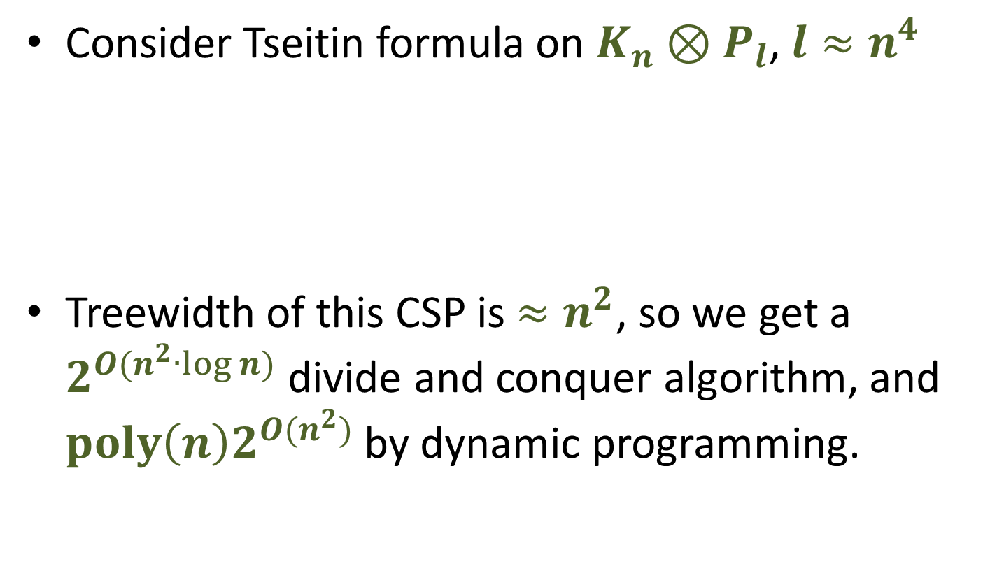
Tseitin formula on Grid-like Graph
Consider Tseitin formula on $K_{n}⊗P_{l}$, $l≈n^{4}$
Treewidth of this CSP is $≈n^{2}$, so we get a $2^{O(n^{2}∙\log{n})}$ divide and conquer algorithm, and $poly\left(n\right)2^{O(n^{2})}$ by dynamic programming.
n
l

Slide 64

Tseitin formula on Grid-like Graph
Consider Tseitin formula on $K_{n}⊗P_{l}$, $l≈n^{4}$
In fact, the algorithms give resolution proofs.
DP: Size $≈poly(n)∙2^{n^{2}}$, Space $≈2^{n^{2}}$.
D&C: Size $≈2^{n^{2}∙log⁡(n)}$, Space $≈poly(n)$.
n
l

Slide 65

Tseitin formula on Grid-like Graph
Consider Tseitin formula on $K_{n}⊗P_{l}$, $l≈n^{4}$
Our lower bound shows that quasipolynomial blow up in size is necessary for proofs of these formulas in space $2^{n^{2}/2}$. $Size≥{\left({2^{.57n^{2}}}/{Space}\right)}^{ω(1)}$
n
l

Slide 66
High Level Overview of Lower Bound
Fundamental idea in Resolution size bounds is “bottleneck counting argument” [Haken].
Think of any truth assignment as following a path in the proof dag, stepping along falsified clauses.
Path starts at empty clause, at the end of the proof.
Branch according to resolved variable.
$$C∨x$$
$$D∨¬x$$
If x = 1…
$$C∨D$$

Slide 67
High Level Overview of Lower Bound
Fundamental idea in Resolution lower bounds is “bottleneck counting argument” [Haken].
Given a distribution of assignments, get a distribution of paths through proof DAG.
Haken’s idea: To show a formula is hard, find a large set of assignments such that in any sound proof, most assignments pass through a wide clause. Since only a small fraction of assignments can falsify a wide clause, this implies there are many wide clauses (bottlenecks in the flow of assignments).

Slide 68


High Level Overview of Lower Bound
Initial Clauses
If each path in distribution hits the middle layer, but probability to hit any particular middle clause is $≤p$, then $\#clauses≥p^{−1}$.
Modern form of the argument uses random restrictions (Beame & Pitassi, FOCS ‘96).
Middle Layer (wide clauses)
$⊥$

Slide 69
High Level Overview of Lower Bound
Initial Clauses
Our idea: If a proof is too short and uses too little space, flow will be too congested to route all paths. Need to consider multiple middle layers.
Middle Layer (wide clauses)
$⊥$

Slide 70

High Level Overview of Lower Bound
Initial Clauses
Suppose that for any particular , , $\operatorname{Pr}\left[ \right]≤p,\operatorname{Pr}\left[ \right]≤p,$ $\operatorname{Pr}\left[ and \right]≤p^{2}.$ Then, ${Size}^{2}∙Space≥p^{−3}$.
Middle Layer 1
Middle Layer 2
$⊥$

Slide 71
High Level Overview of Lower Bound
To see this, subdivide proof into many epochs and count how many paths flow across both layers in any single epoch vs. over several epochs. Previously, this argument was only known for expanders and superconcentrators.
In general, if you have $l$ layers, and for any $k$ clauses in distinct layers, $\operatorname{Pr}{[reach all]}≤p^{k}$, $Size≥{\left({p^{−1}}/{Space}\right)}^{Ω\left({\log{l}}/{\log{\log{l}}}\right)}$

Slide 72
Extended Isoperimetric Inequality
If the sets aren’t essentially blocks, we’re done.
If they are blocks, reduce to the line:

Slide 73
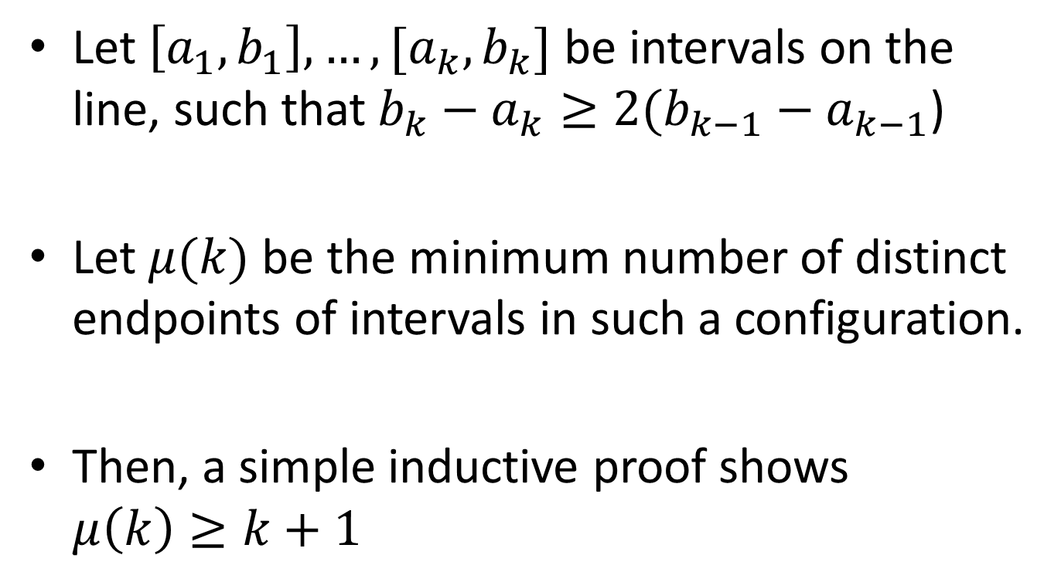
Intervals on the line
Let $\left[a_{1},b_{1}\right],…,[a_{k},b_{k}]$ be intervals on the line, such that$b_{k}−a_{k}≥2(b_{k−1}−a_{k−1}$)
Let $μ(k)$ be the minimum number of distinct endpoints of intervals in such a configuration.
Then, a simple inductive proof shows $μ\left(k\right)≥k+1$

Slide 74
Proof DAG
Notes:
Commentary:
For somewhat unnatural formulas, exponential separations are known.
For e.g. Pigeonhole Principle, Tseitin, conjectured in 2007 Pitassi Urqhart that the optimal size proofs are regular.
Tseitin ‘68 suggested that Regular & General could be equal, spent a long time trying to prove this.

Slide 75
Proof DAG
“Regular”: On every root to leaf path,
no variable resolved more than once.
Notes:
Commentary:
For somewhat unnatural formulas, exponential separations are known.
For e.g. Pigeonhole Principle, Tseitin, conjectured in 2007 Pitassi Urqhart that the optimal size proofs are regular.
Tseitin ‘68 suggested that Regular & General could be equal, spent a long time trying to prove this.

Slide 76
Tradeoffs for Regular Resolution
Theorem : For any k, 4-CNF formulas (Tseitin formulas on long and skinny grid graphs) of size n with
Regular resolution refutations in size n^{k+1}, Space n^{k}.
But with Space only n^{k-ε}, for any ε > 0, any regular resolution refutation requires size at least n^{ε log log n / log log log n}.

Slide 77
Regular Resolution
Can define partial information more precisely
Complexity is monotonic wrt proof DAG edges. This part uses regularity assumption, simplifies arguments with complexity plot.
Random Adversary selects random assignments based on proof
No random restrictions, conceptually clean and don’t lose constant factors here and there.

Slide 78
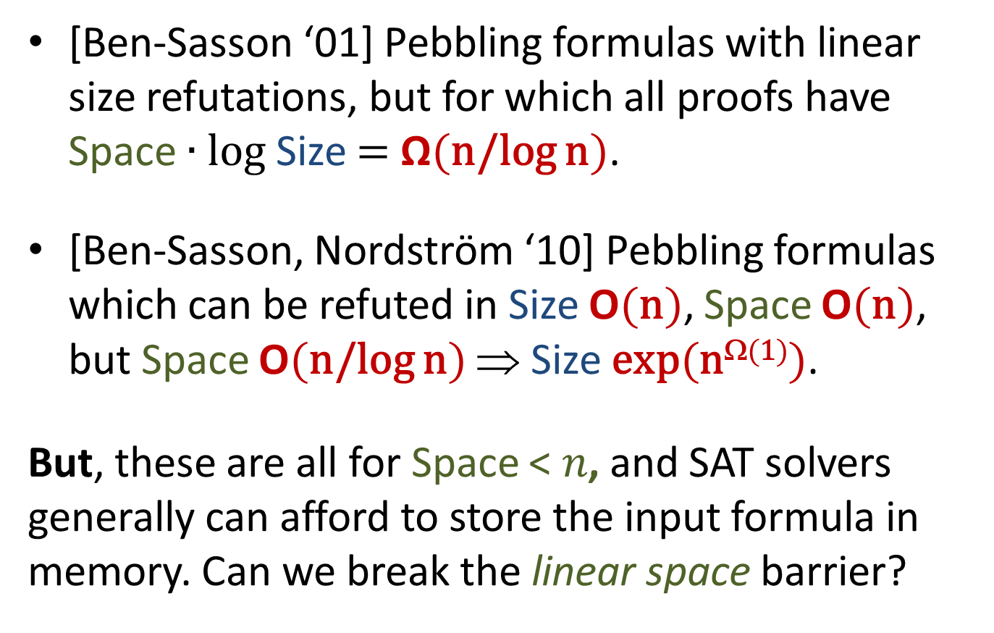
Size-Space Tradeoffs for Resolution
[Ben-Sasson ‘01] Pebbling formulas with linear size refutations, but for which all proofs have Space $∙$ log Size $=$ Ω(n/log n).
[Ben-Sasson, Nordström ‘10] Pebbling formulas which can be refuted in Size O(n), Space O(n), but Space O(n/log n) ⇒ Size exp(n^{Ω(1)}).
But, these are all for Space < 𝑛, and SAT solvers generally can afford to store the input formula in memory. Can we break the linear space barrier?

Slide 79
Warmup Proof: Many Clauses
A restriction is a partial assignment to the variables of a formula, resulting in some simplification.
n
l

Slide 80
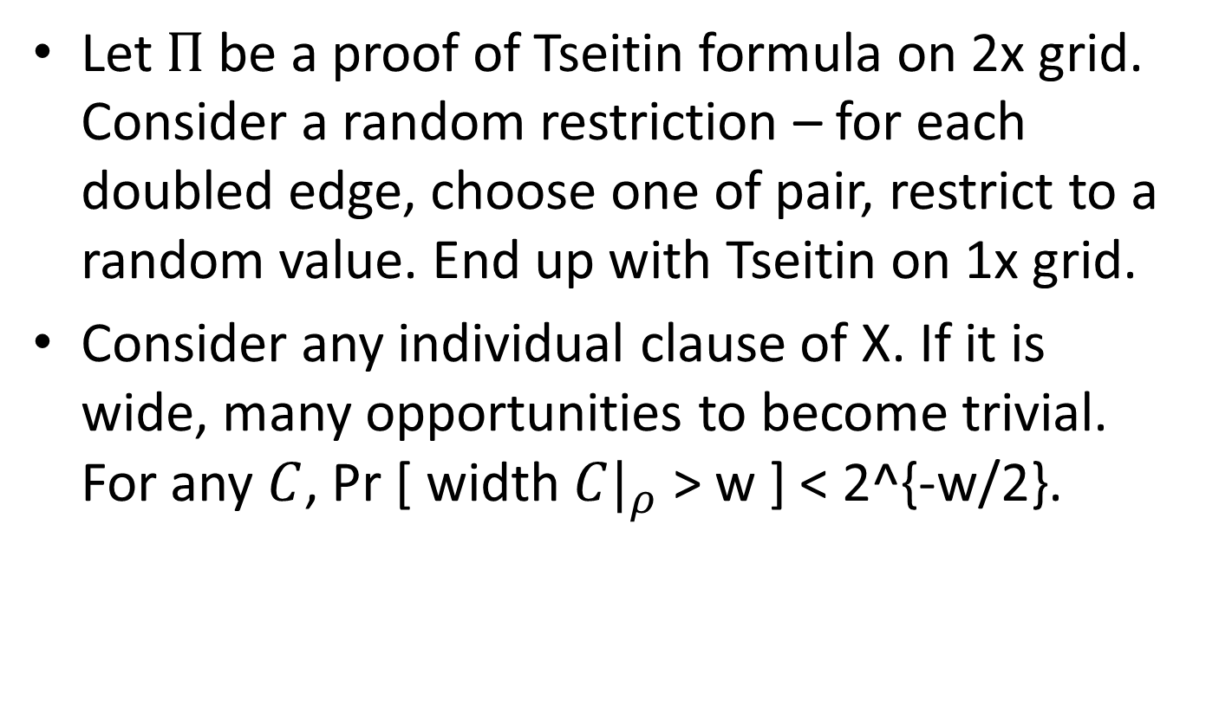
Techniques of Proof
Let $Π$be a proof of Tseitin formula on 2x grid. Consider a random restriction – for each doubled edge, choose one of pair, restrict to a random value. End up with Tseitin on 1x grid.
Consider any individual clause of X. If it is wide, many opportunities to become trivial. For any $C$, Pr [ width ${C|}_{ρ}$ > w ] < 2^{-w/2}.

Slide 81
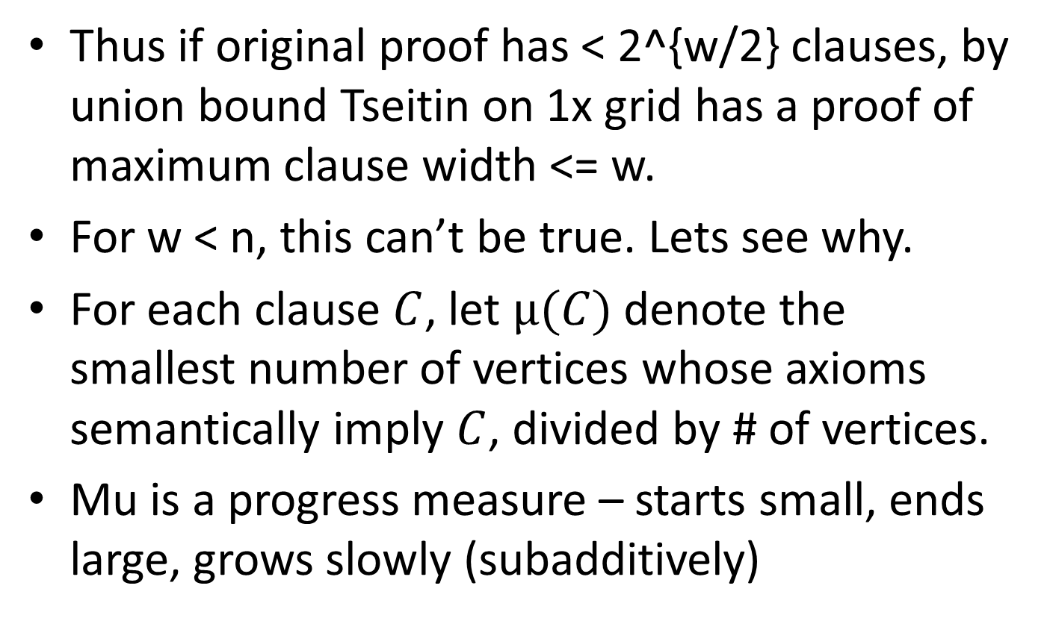
Techniques of Proof
Thus if original proof has < 2^{w/2} clauses, by union bound Tseitin on 1x grid has a proof of maximum clause width <= w.
For w < n, this can’t be true. Lets see why.
For each clause $C$, let $μ(C)$ denote the smallest number of vertices whose axioms semantically imply $C$, divided by # of vertices.
Mu is a progress measure – starts small, ends large, grows slowly (subadditively)

Slide 82
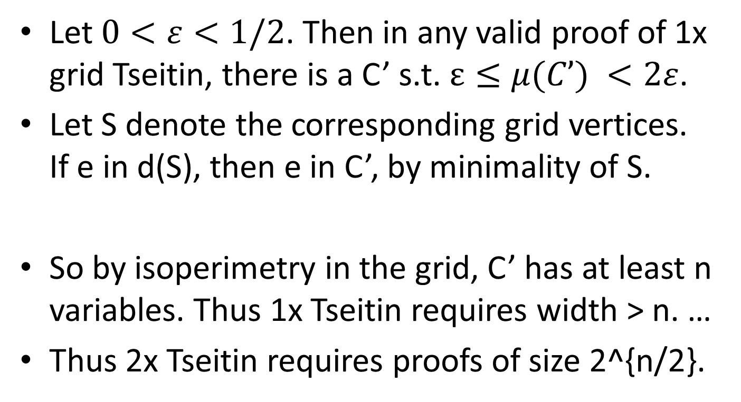
Techniques of Proof
Let $0<ε<1/2$. Then in any valid proof of 1x grid Tseitin, there is a C’ s.t. $ε≤μ(C’) <2ε$.
Let S denote the corresponding grid vertices. If e in d(S), then e in C’, by minimality of S.
So by isoperimetry in the grid, C’ has at least n variables. Thus 1x Tseitin requires width > n. …
Thus 2x Tseitin requires proofs of size 2^{n/2}.

